Slide 1
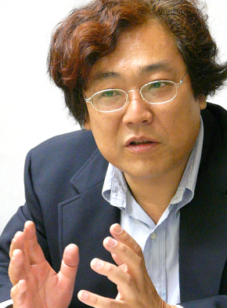
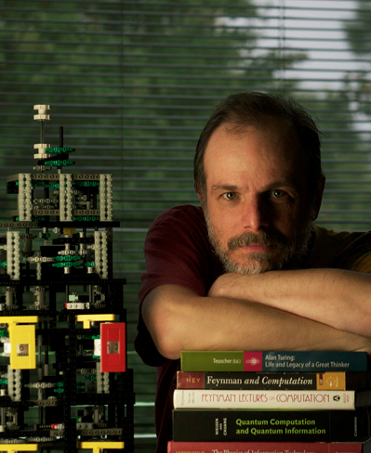
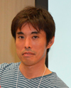

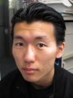

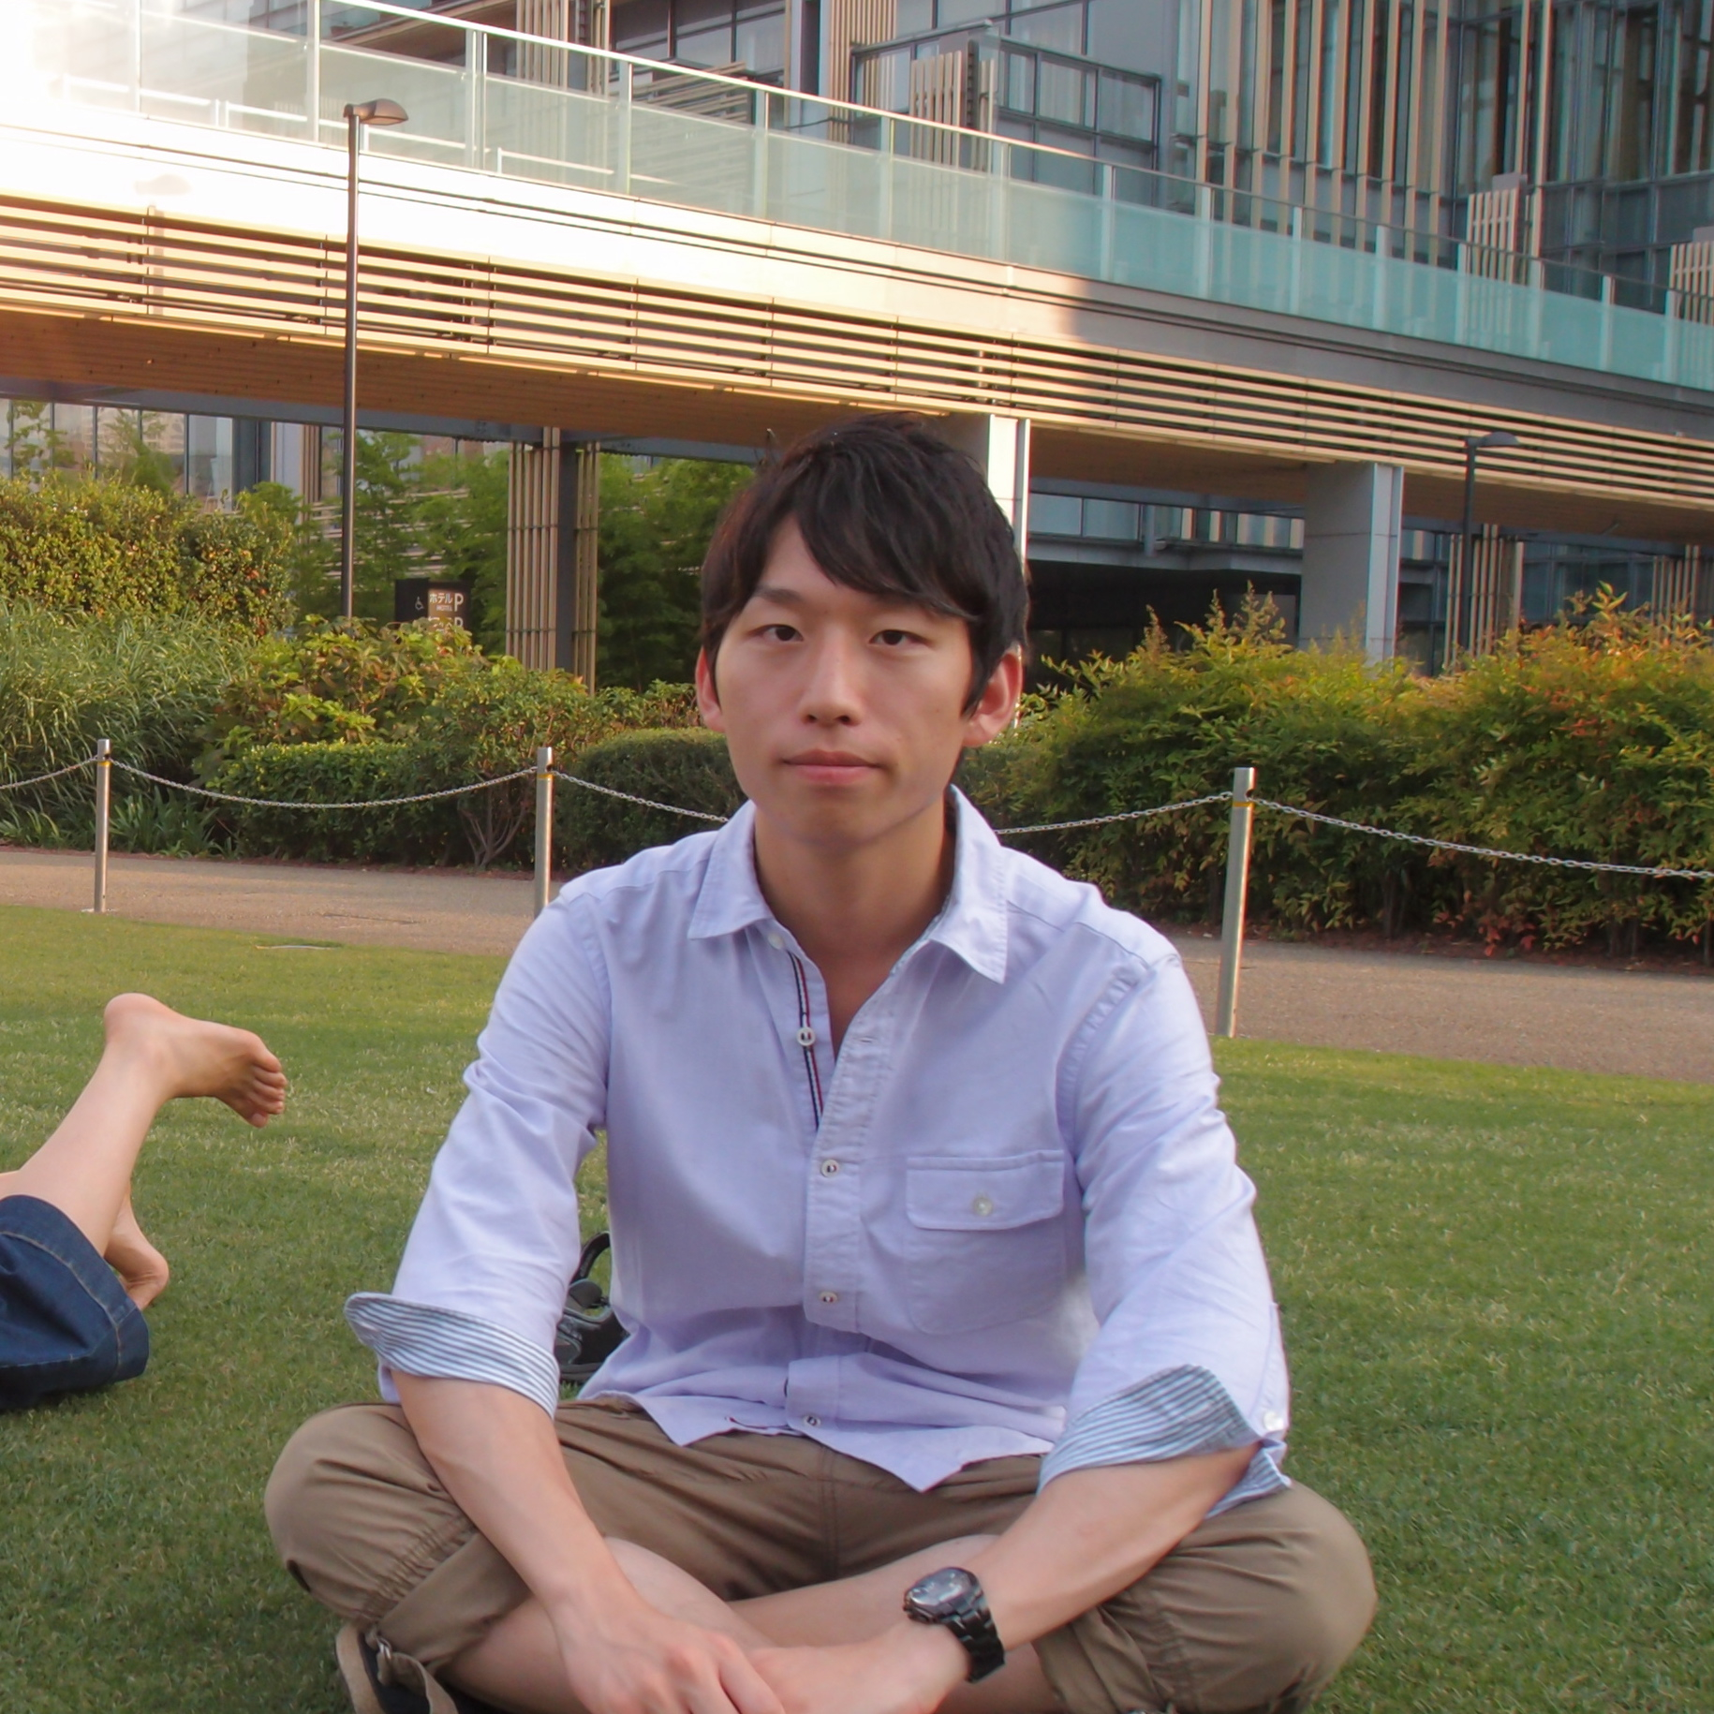
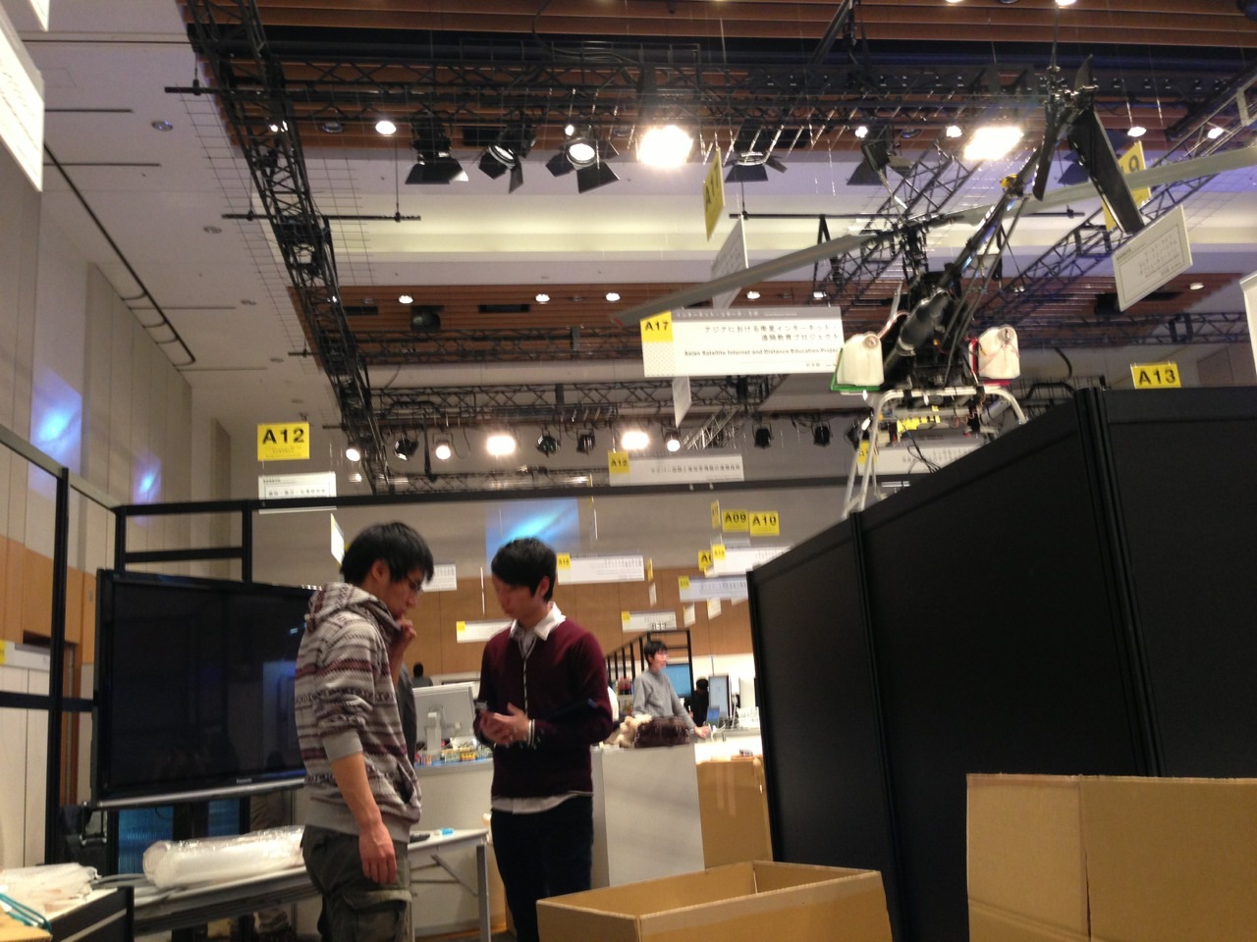

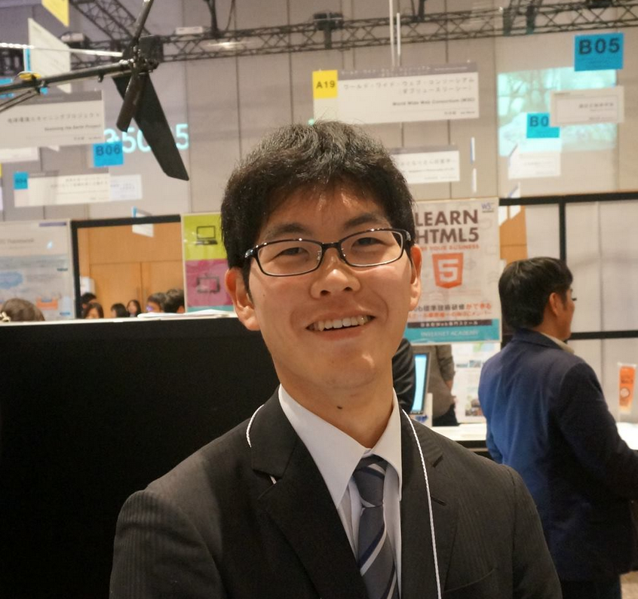
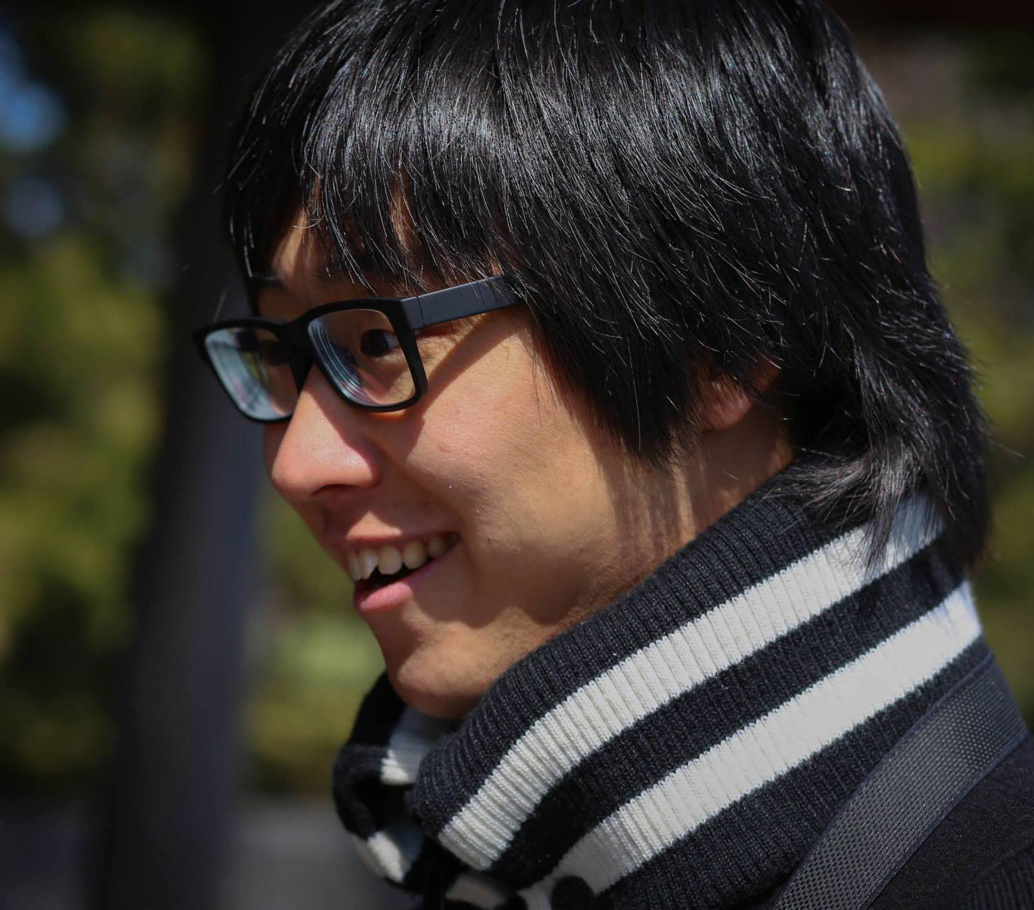
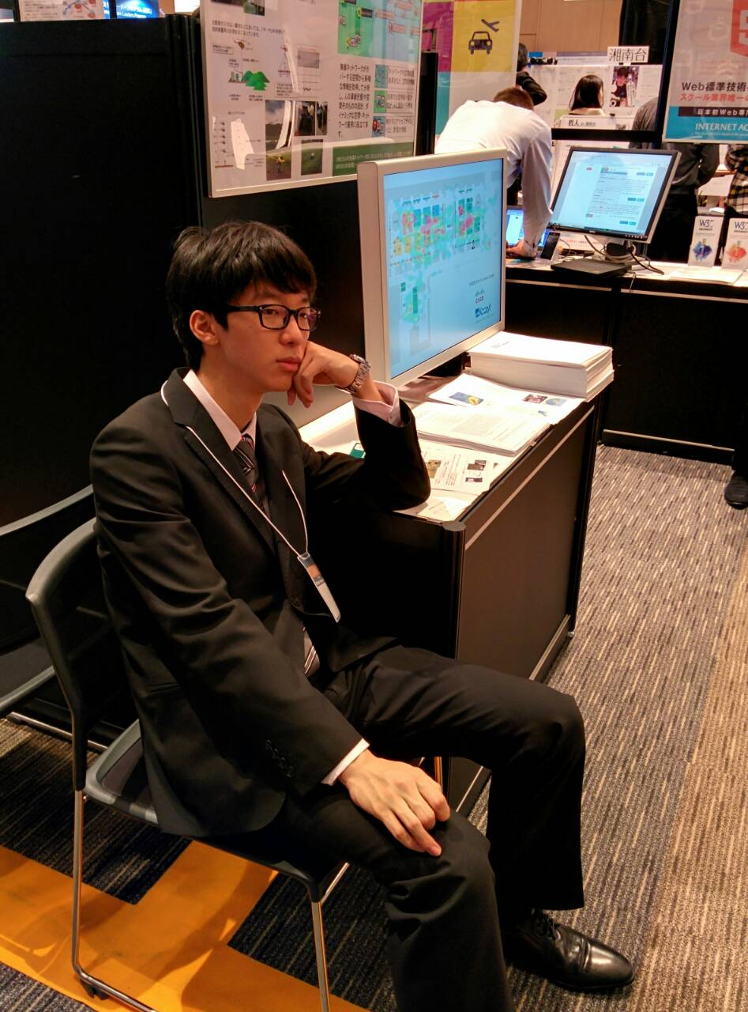

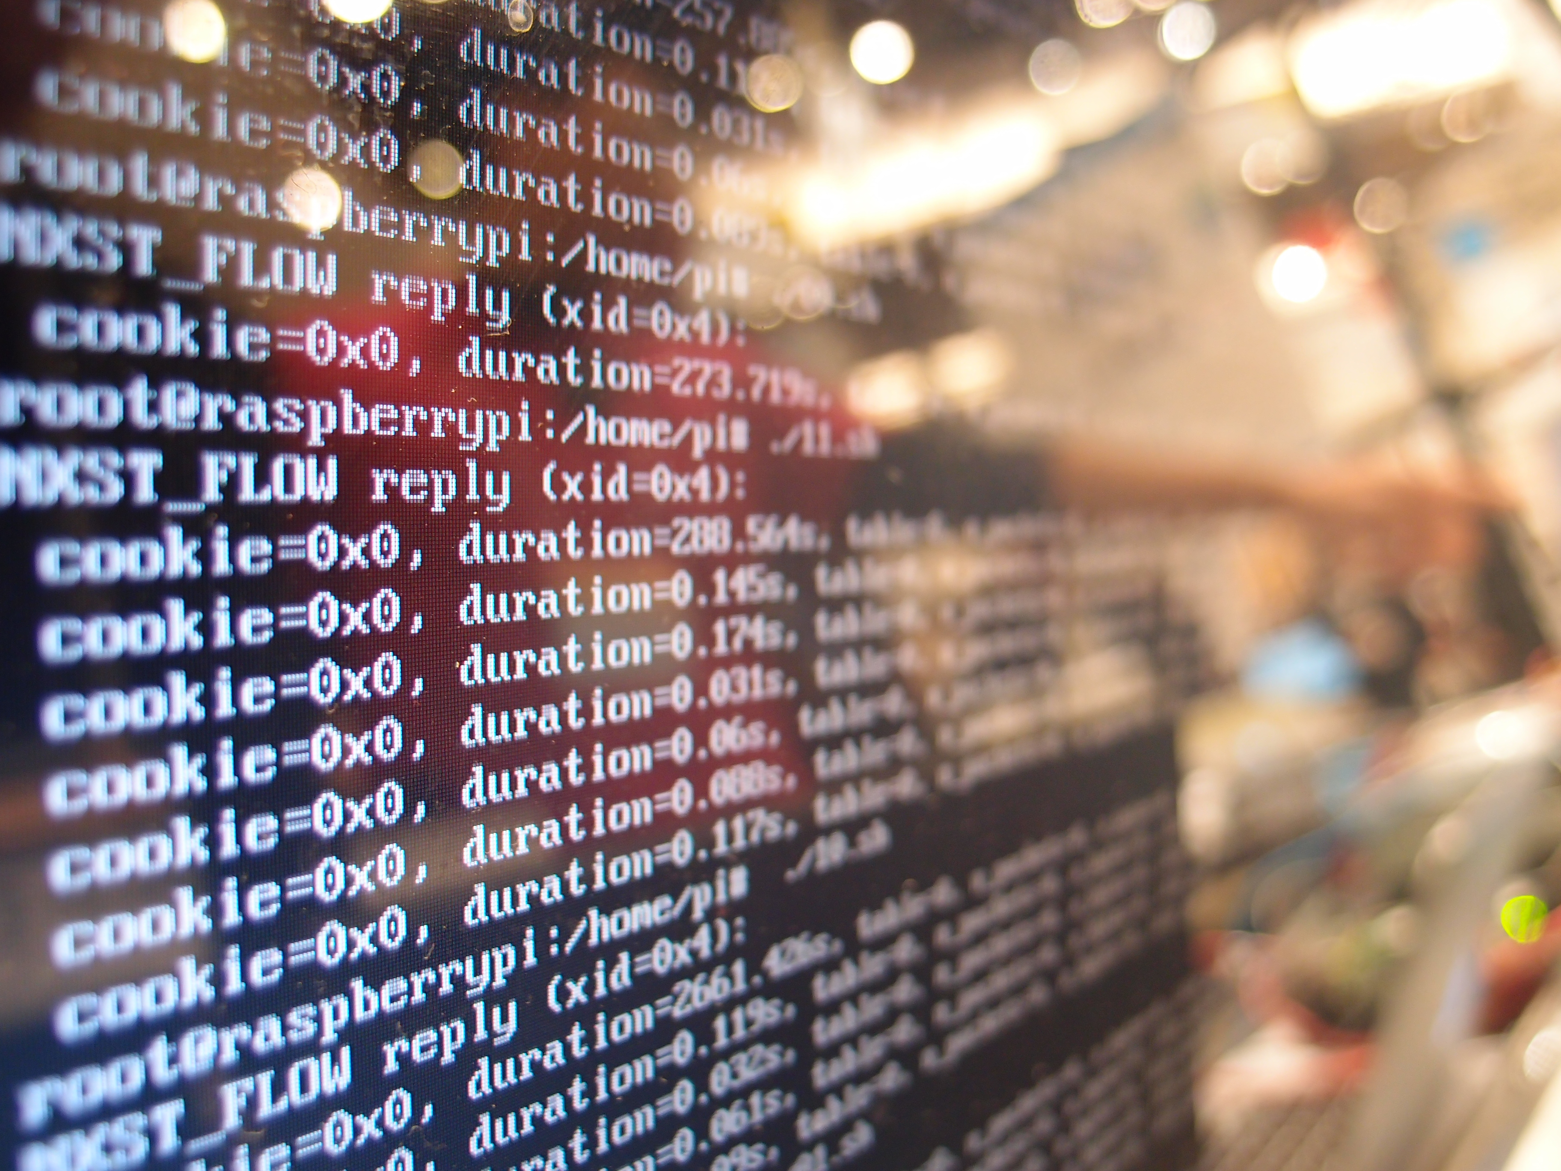
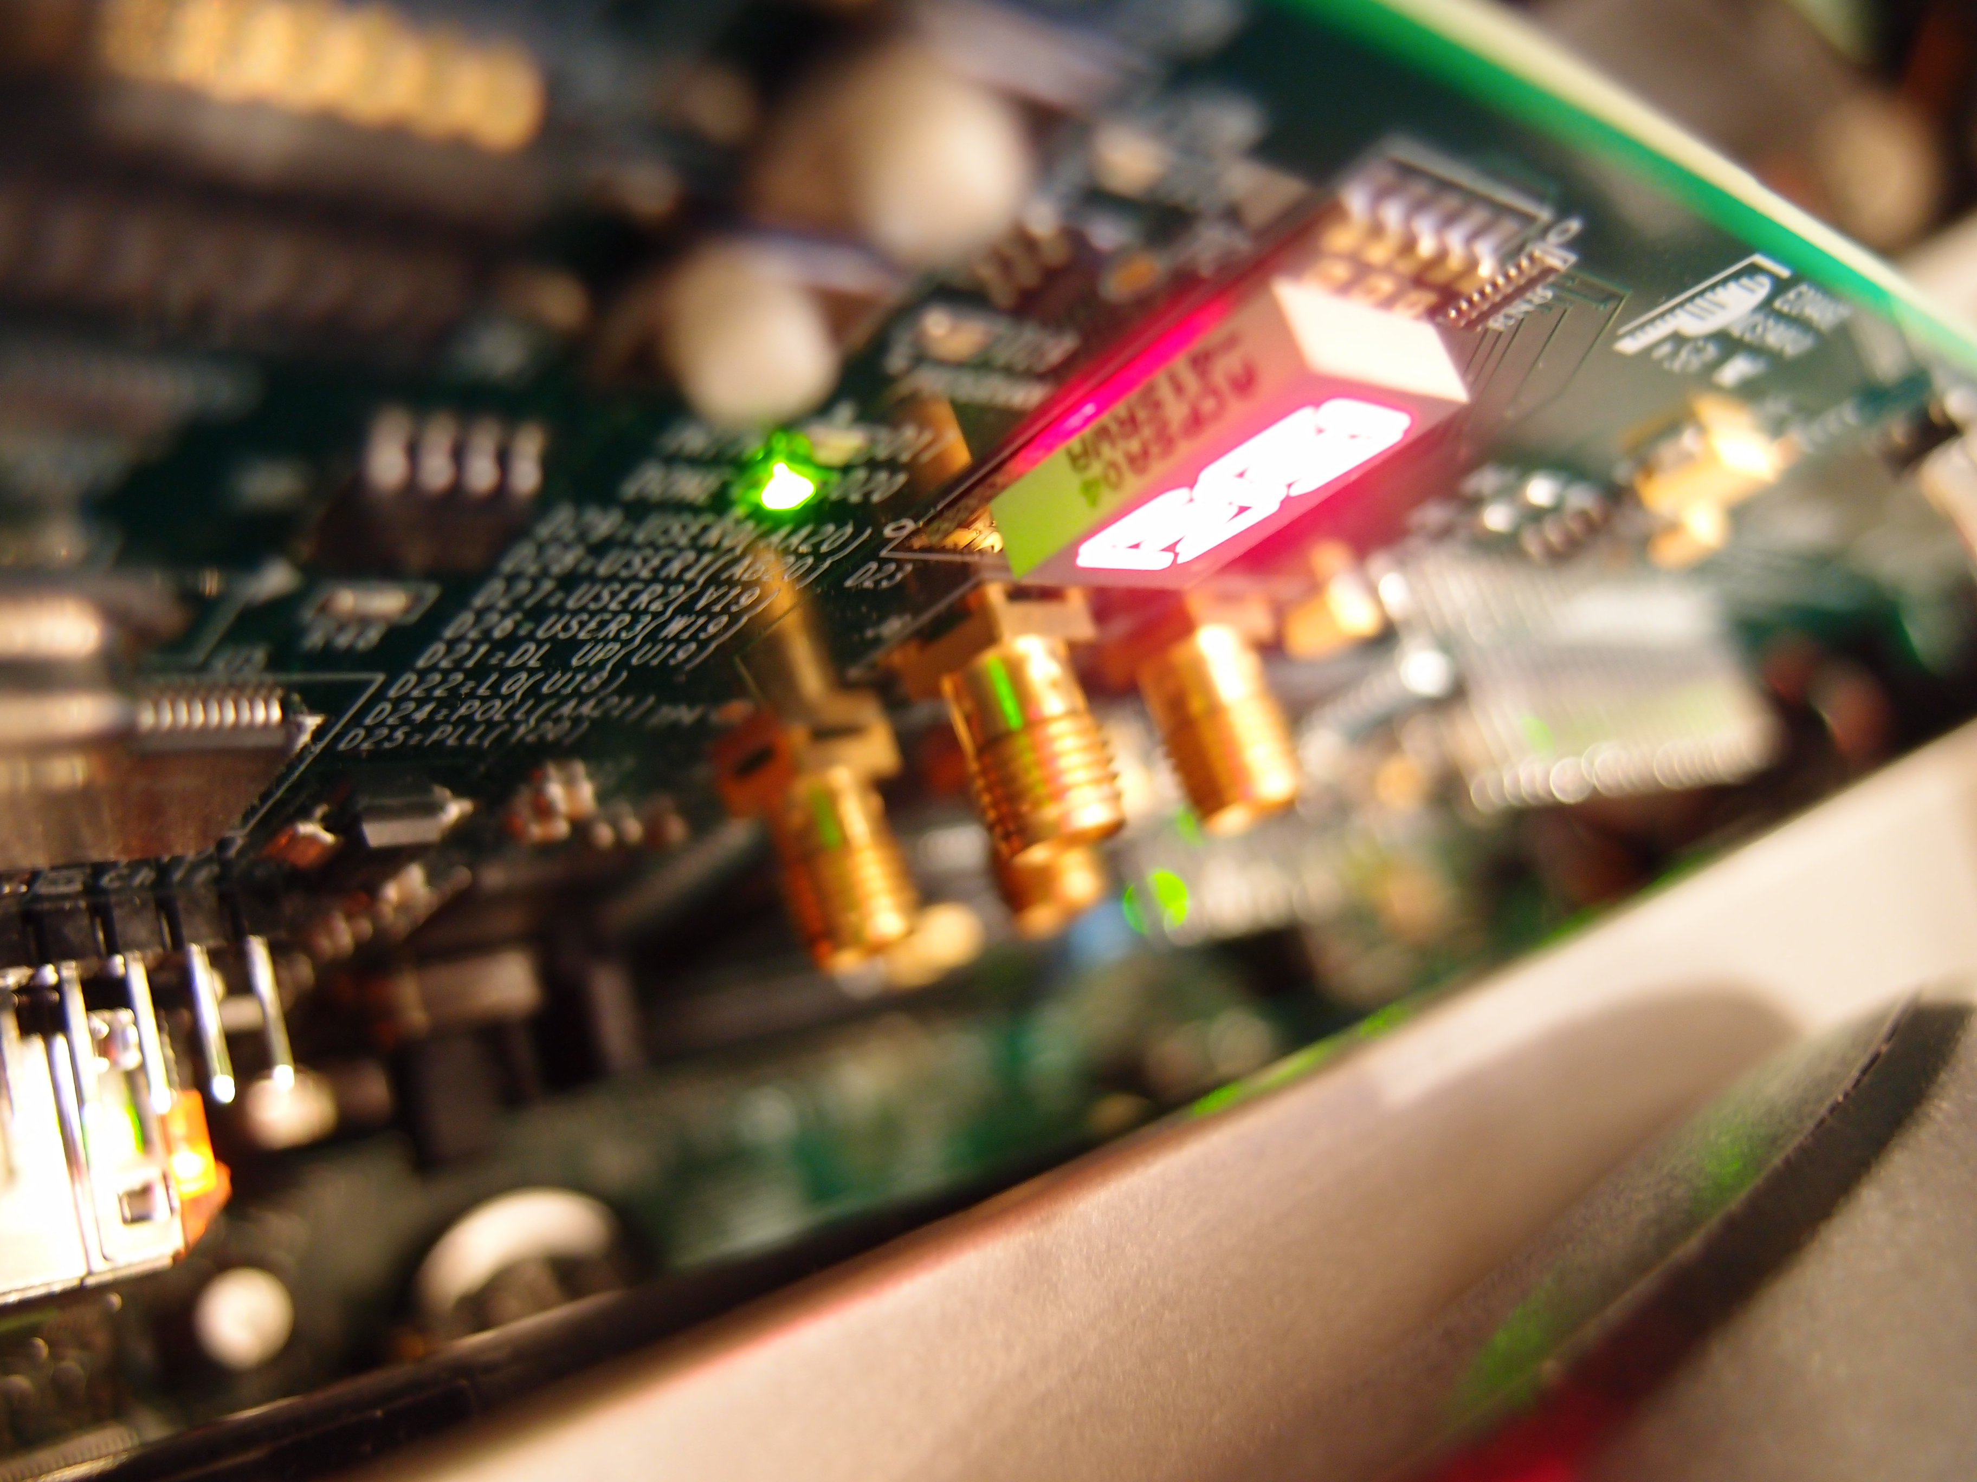
Arch
Computer architecture
Software architecture
W
e propose, build and manage the next-generation network architecture and computer architecture. Our research topics are construction of the hardware system which anyone can reproduce, Precise
communication delay measurement, Development of the parallel programming language, Visualization of the information and so on.
Member
Faculty
Faculty
Doctor
Osamu Nakamura
osamu
Web, IPv6, Wireless
Rodney Van Meter
rdv
Quantum Computing
Takeshi Matsuya
macchan
Network Environment by FPGA
Doctor
Master
B3
Yohei Kuga
sora
Network Measurement
Takuya Shibuta
bhangra
Network Routing
Toshinari Takahashi
seibe
Visualization of Low Level Layer
Technology
B3
B3
B2
Atsuki Demizu
demmy
Programming Language
Ryutaro Ono
ryuu
FPGA
Kotaro Oki
kucats
Distributed Computing
B2
B2
B2
Masahiko Hara
pasora
Computing
Reo Nakayama
leopon
Web
Shingo Sato
hal
Parallel Computing
B2
Naohiro Okada
naohiro
( to be determined )
B2
hoshikyu, miyukki, shunkin, usk
B1
gucchan, wattu
Research
EtherPIPE: an Ethernet character device for network scripting
Yohei Kuga, Takeshi Matsuya, Hiroaki Hazeyama, Kenjiro Cho, Osamu Nakamura
The UNIX command tools are designed to combine simple generic commands to accomplish various complex tasks. Meanwhile, in network programming, we often end up writing many similar functions and packaging functions of all network layers to build an application.
We propose EtherPIPE, a character network I/O device, that allows the programmer to access network traffic data as a file through UNIX commands. By setting a UNIX pipe “|” from or to EtherPIPE’s output or input with UNIX com- mands, packets can be easily processed, executing functions such as packet filtering, packet capturing, generating arbi- trary packets, and rewriting header information.
Realizing a Low Latency Video Conference System
Yuta Tokusashi, Takeshi Matsuya
True real-time communication on the Internet is not possible due to the latency caused by the software video codec. We propose a low latency video conference system which processes everything on hardware.
In this method, the system processes everything on FPGA, including the processing of the network protocol stack. As a result, we achieved 650μsec latency on encoding and decoding of the video and processing of network.

